Slide 1
Indian Personal Finance & Spending Habits

Slide 2
Objectives
To understand how income levels among people with different occupations and living in various city tiers.
To study the spending habits of individuals on key needs such as rent, groceries, transport, and entertainment.
To examine how expenditures affect a person’s disposable income and overall savings potential.
To explore the link between age, income, and the percentage of income people wish to save.
.

Slide 3
Data Cleaning and Preparation
Removed duplicate and incomplete responses.
Handled missing values using mean substitution for numerical columns.
Ensured consistency between income, expenses, and savings columns.
Created calculated measures using “DAX”

Slide 4
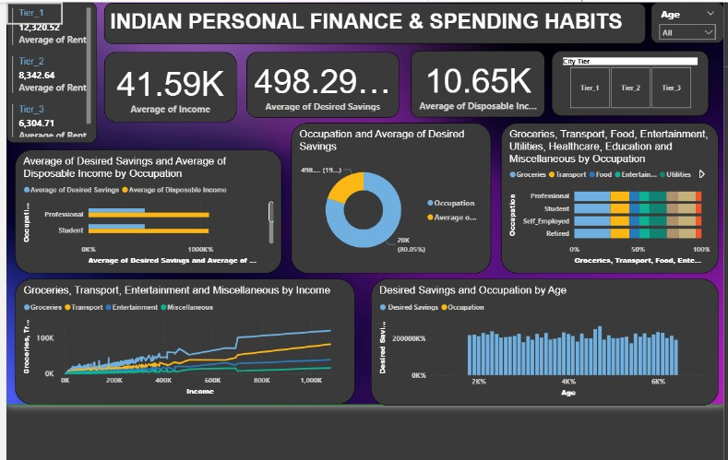

Slide 5
Key Insights from Dashboard
Average Monthly Income: ₹41.6K
Average Desired Savings: ₹498.3K
Avg. Disposable Income: ₹10.65K.
Professionals and students show higher savings aspirations compared to disposable income.
City Tier 1 respondents report the highest rent and income levels.
Major spending areas are groceries, transport, and entertainment.
20–30 years age group shows strong savings intent but limited disposable income.

Slide 6
Observations
Occupation strongly influences financial patterns: Professionals save more, while students aspire more.
Spending on entertainment and food is highest among younger and student segments.
Income growth directly correlates with grocery and transport expenses.
Desired savings appear relatively stable across age groups.
Tier 2 and 3 residents maintain lower rent but similar expense ratios.

Slide 7
Recommendations
Promote financial literacy to align desired and achievable savings goals.
Encourage investment education for younger individuals.
Introduce occupation-specific saving and budgeting tools.
Policy focus on rent control and cost-of-living support in Tier 1 cities.
Incentivize savings through digital banking and investment awareness.

Slide 8
Conclusion
The analysis highlights that while income and expenses vary widely by occupation and city tier, the aspiration to save remains strong across all groups. Bridging the gap between desired and actual savings through financial literacy, smart budgeting, and policy support can improve India’s overall financial well-being.

